Slide 1

RASD
Sara Pidò 894744
Chiara Plizzari 893901
Giuseppe Severino 898458

Slide 2
What are the main goals of the system? (1)
[G1] A user should be able to go to a meeting.
[G4] The time or the location of a meeting can be modified.
[G5] A user should be able to unsay a meeting.
[G6] A user should be able to have some preferences for the trip.
[G6.1] A user should be able not to use some travel means.
[G6.2] A user should be able not to walk more than a specific distance.
[G6.3] A user should be able to minimize carbon footprint when he/she goes to a meeting.
[G7] A user should be able to know every possible option to go to a meeting with different travel means in order to choose the suitable one.

Slide 3
What are the most important three to five requirements?
The most important prerequisite is:
“The system should allow only registered users to log in.”
Other important requirements are:
The system should allow registered users to create meetings.
The system should be able to calculate necessary time for each trip option.
The system must keep track of user's preferences.

Slide 4
What are the most important assumptions?
[A1] Accurate registered user's location is known by GPS.
[A2] The user knows the right details about the activities.
[A3] The public transportations are always in time.
[A4] The external third part services (e.g. vehicle sharing systems, google maps, travel means' websites ecc...) work correctly.
[A5] The news about the traffic, the weather and strikes are correct and known in advance.
[A6] Maps are always updated.
[A7] The user attends meetings in existing locations.
[A8] Public transportations have services that allow a user to buy tickets online.

Slide 5
What are its boundaries? (1)
Dependencies
[DE1] The application depends on external application and websites for some services, such as: the purchase of public transportation's tickets, the use of vehicle sharing systems.
[DE2] The application bases on some other services like Google Maps, weather services and traffic services and uses the received information to guarantee its services.
Constraints
[C1] Travlendar+ requires a smartphone or a tablet with internet connection in order to offer its functionalities.
[C2] Travlendar+ needs a GPS service to find the correct location of the user.

Slide 6
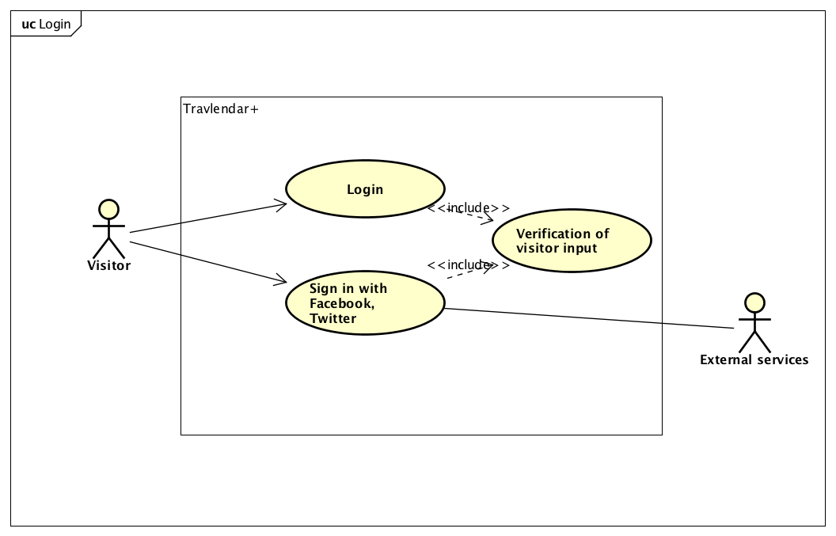
What are the meaningful use cases? [1/2]

Slide 7
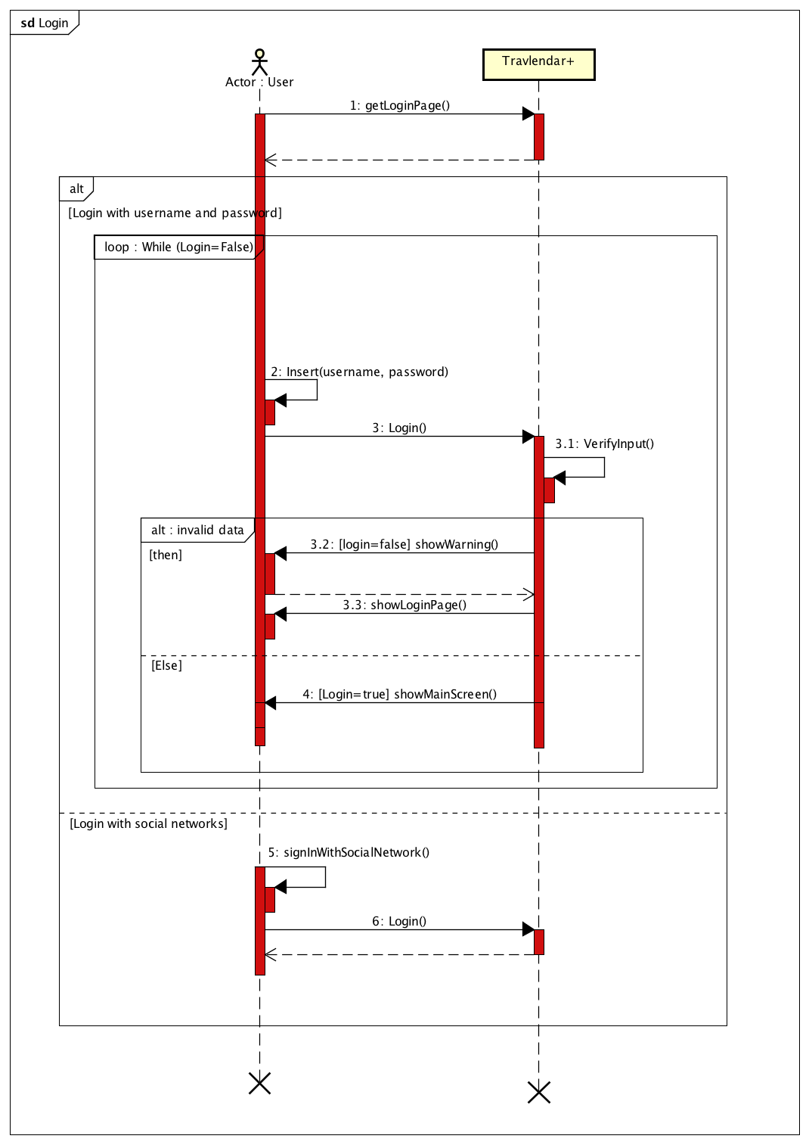

Slide 8
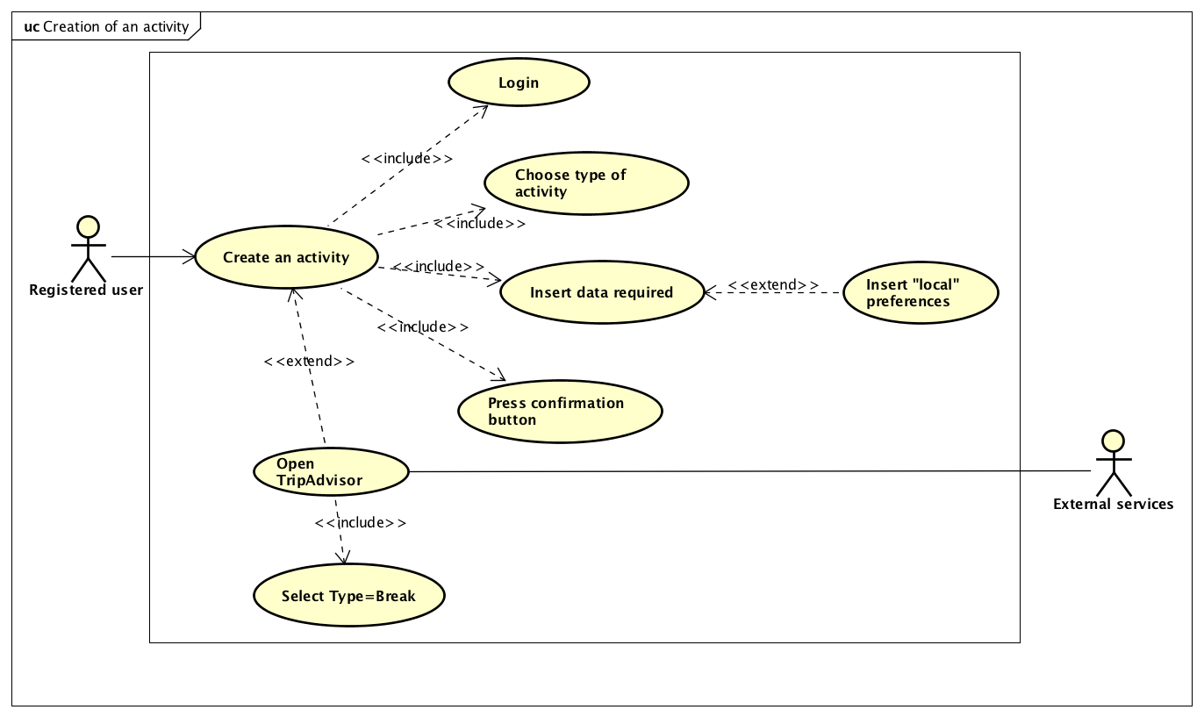
What are the meaningful use cases? [2/2]

Slide 9
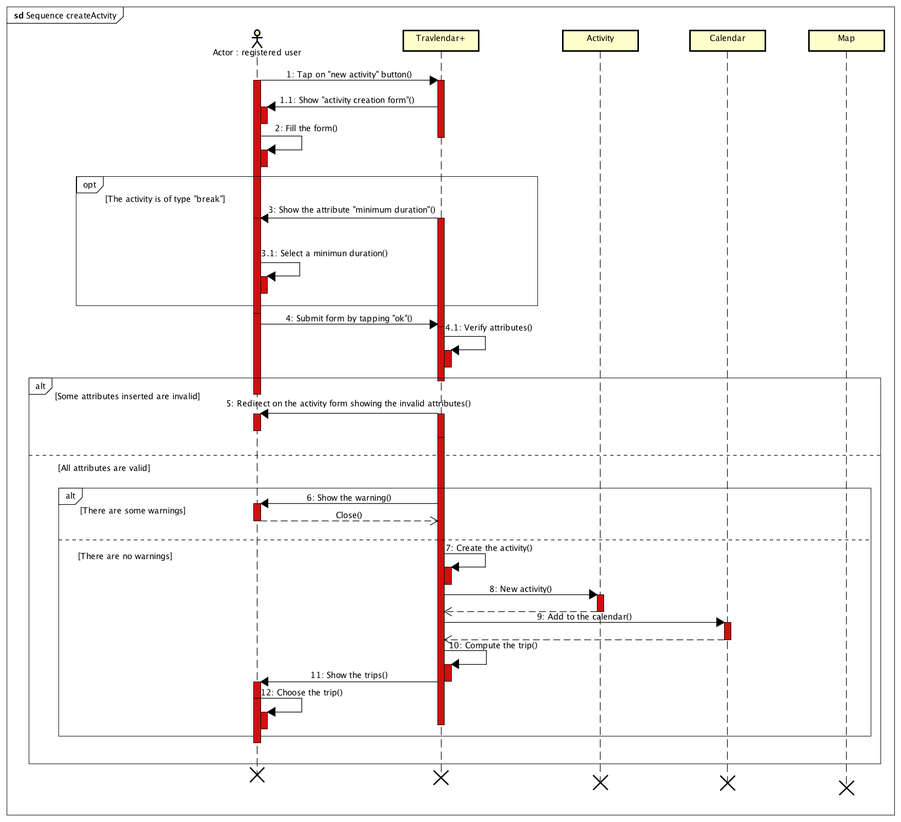

Slide 10
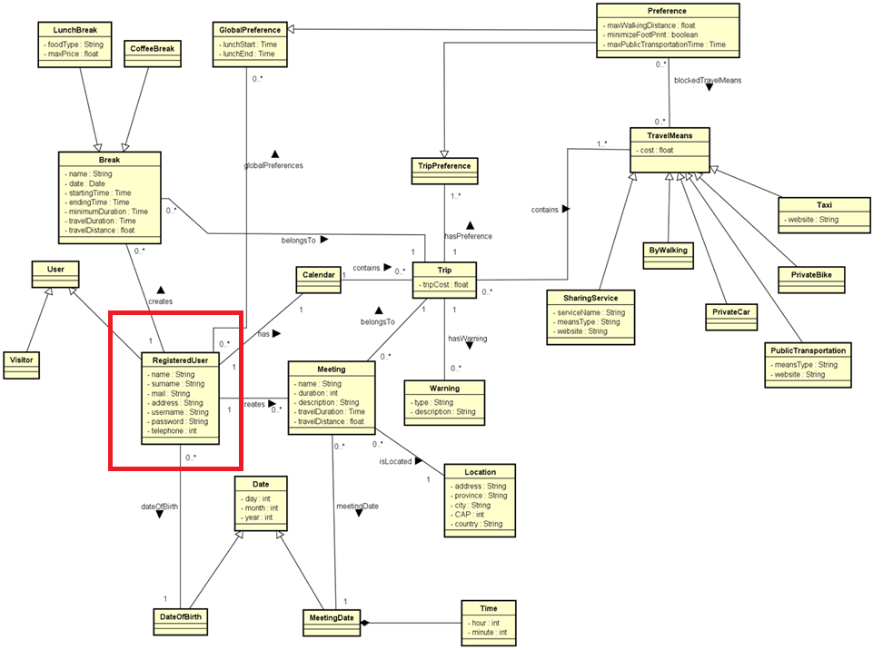
Class diagram

Slide 11
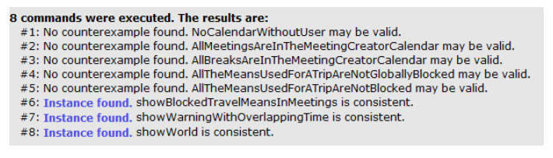
Alloy model
We use Alloy to prove the consistency of our created model.
We want to prove the correctness of our model and to verify the most important properties.

Slide 12
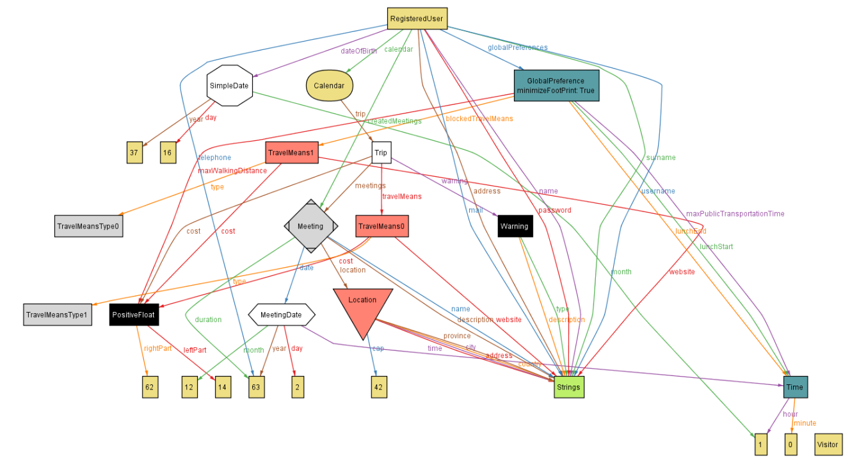
Example: showBlockedTravelMeansInMeetings predicate

Slide 13
Document Design

Slide 14
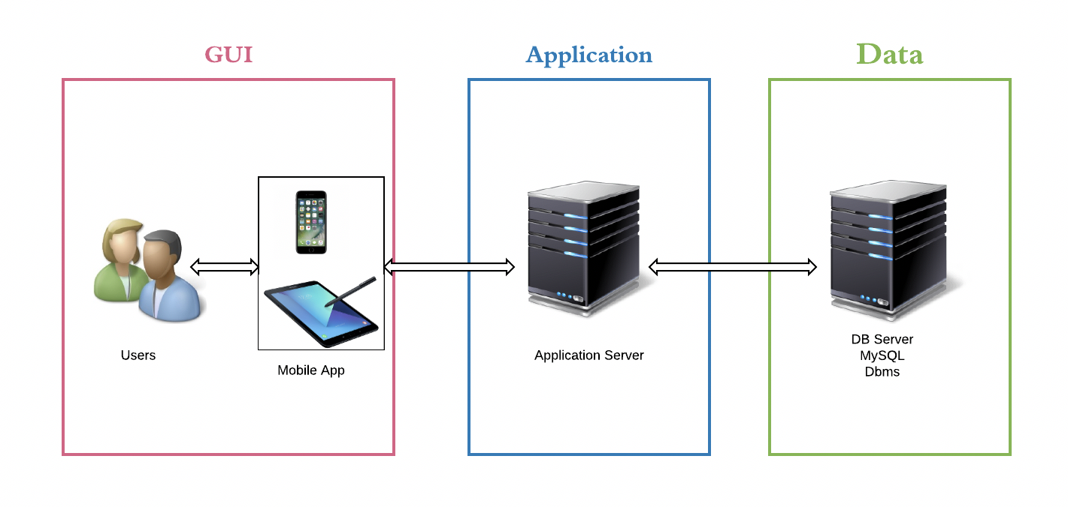
Architectural design

Slide 15
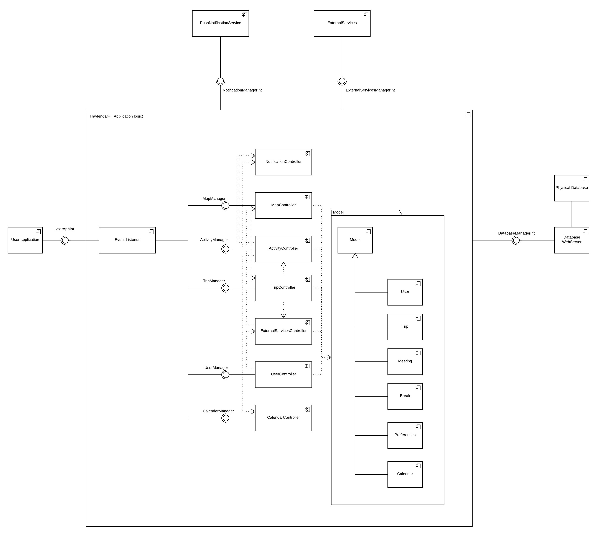
Component View

Slide 16
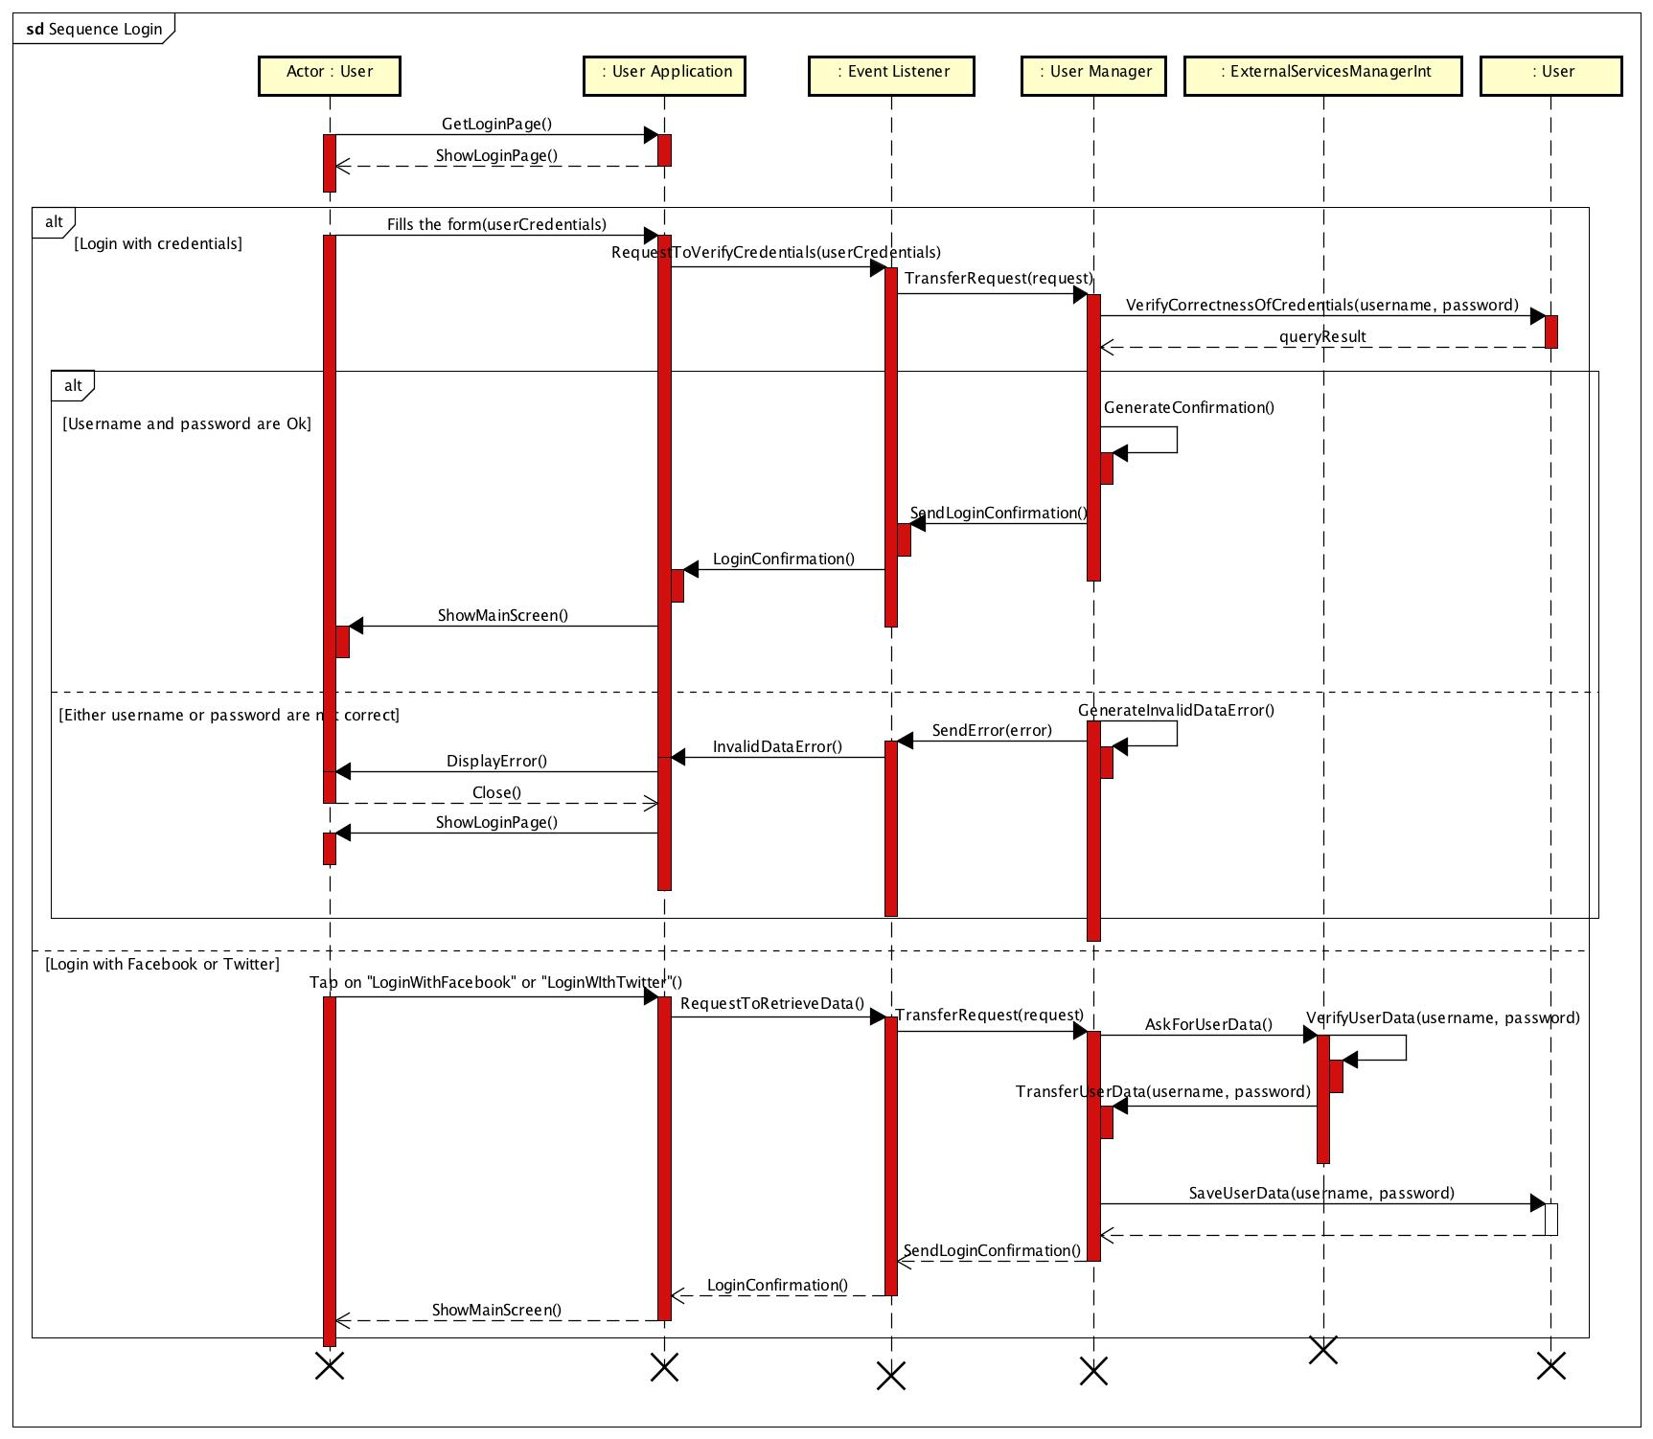
Runtime view [1/2]

Slide 17
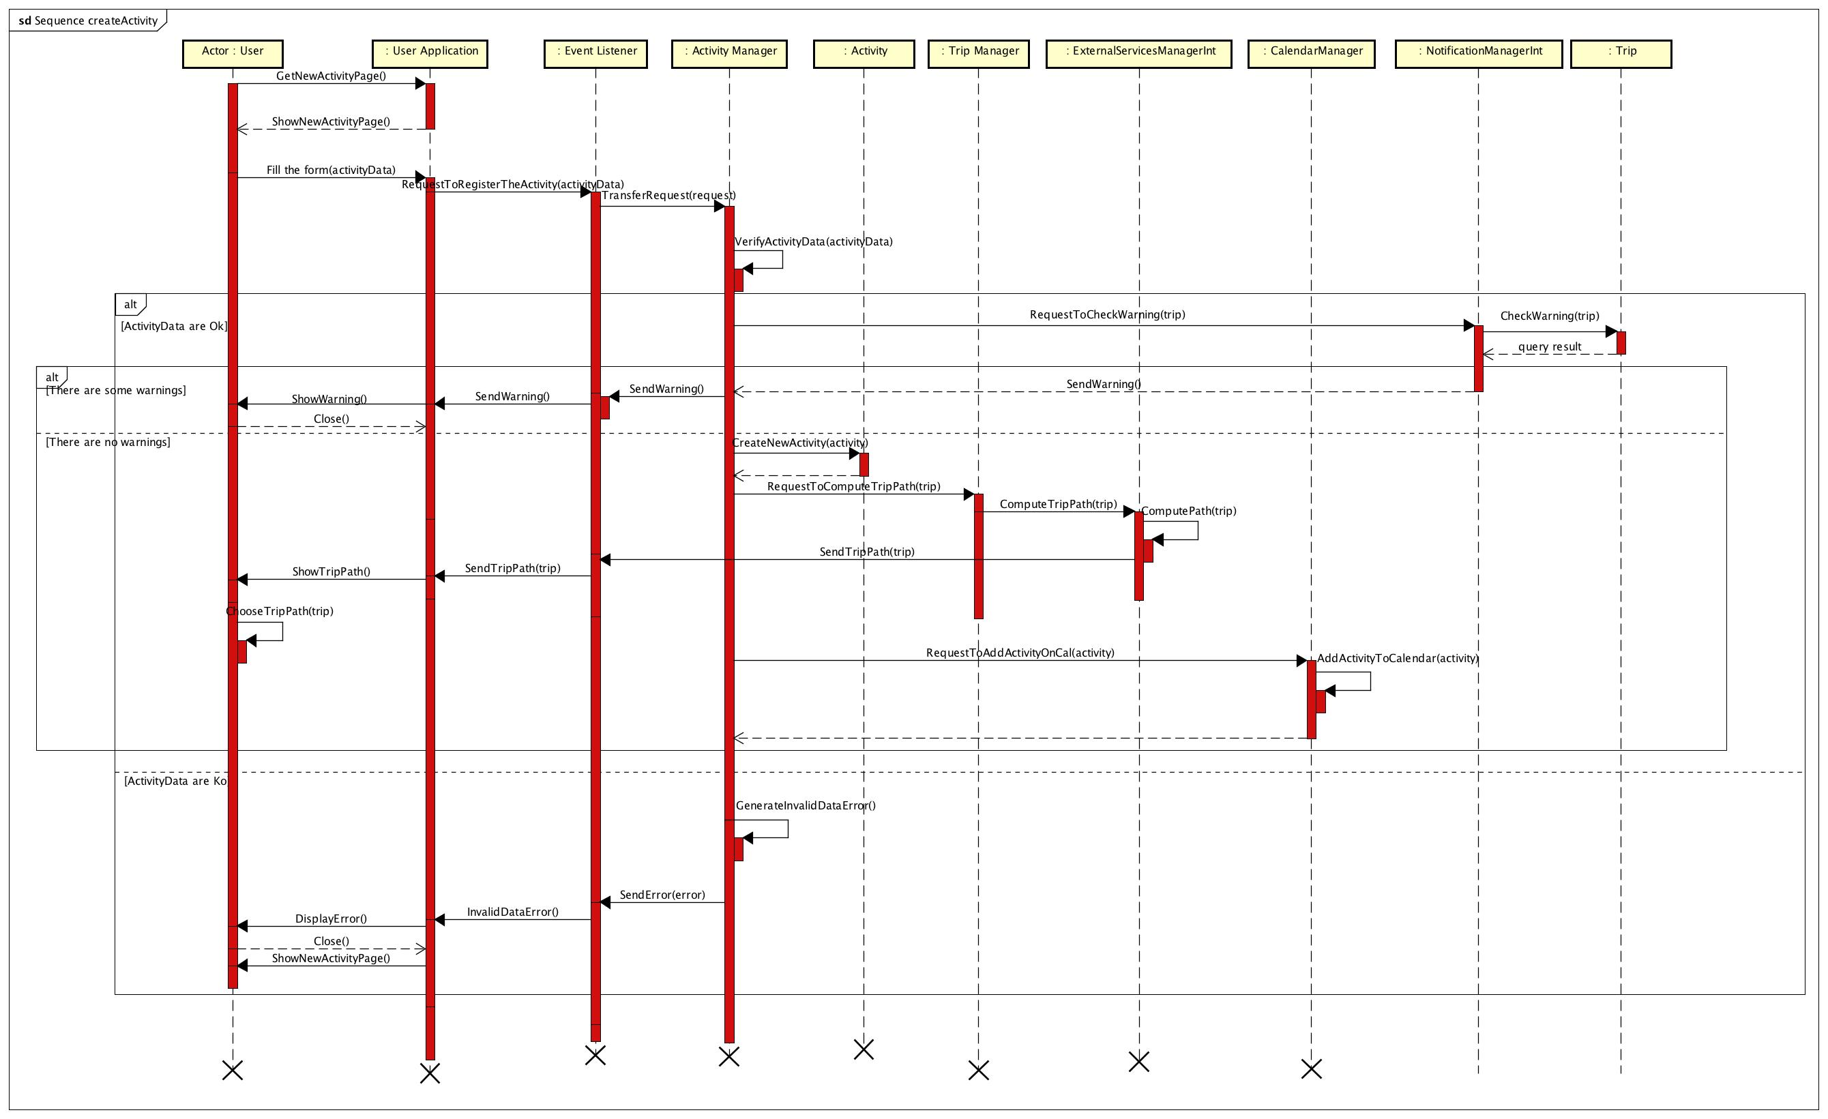
Runtime view [2/2]

Slide 18
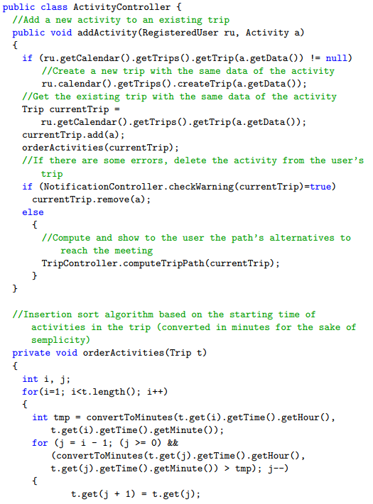
Algorithm design: adding an activity [1/2]
AddActivity is the function called by the Event Listener when a registered user insert a new activity in Travlendar+

Slide 19
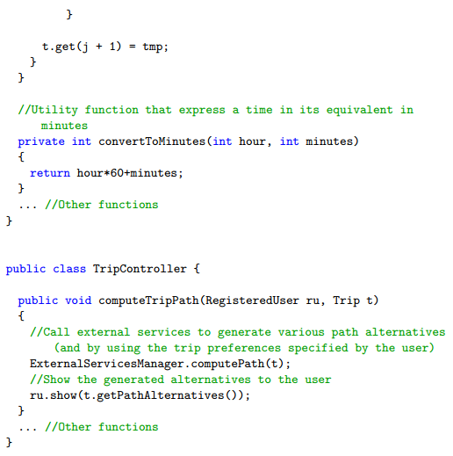
Algorithm design: adding an activity [2/2]

Slide 20
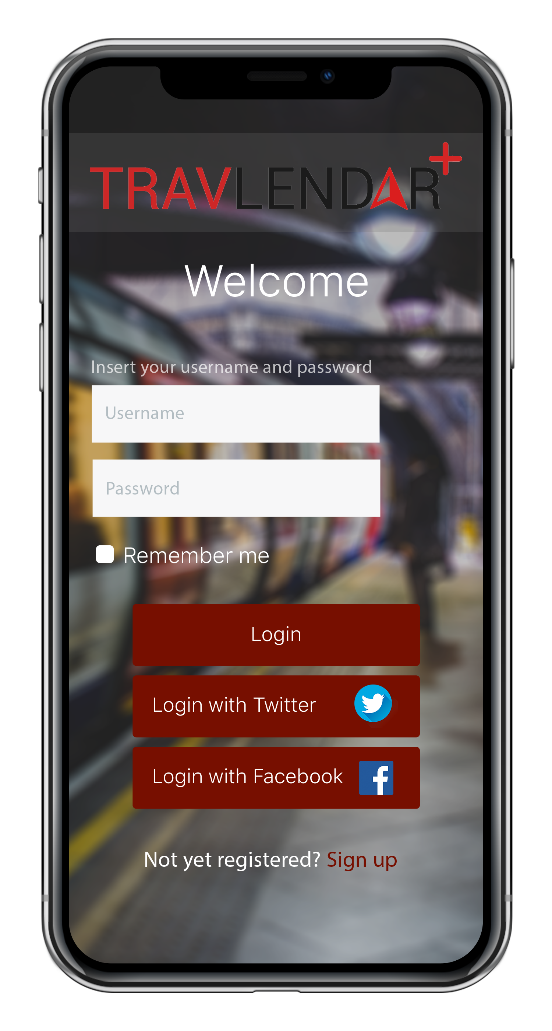
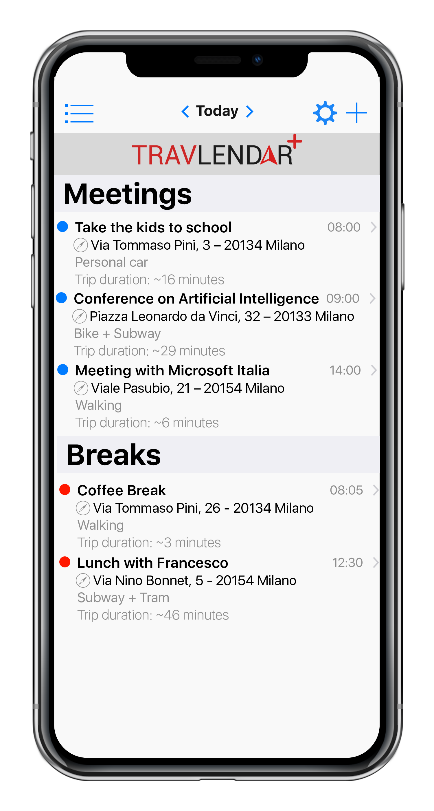
Some Mockups (1)

Slide 21
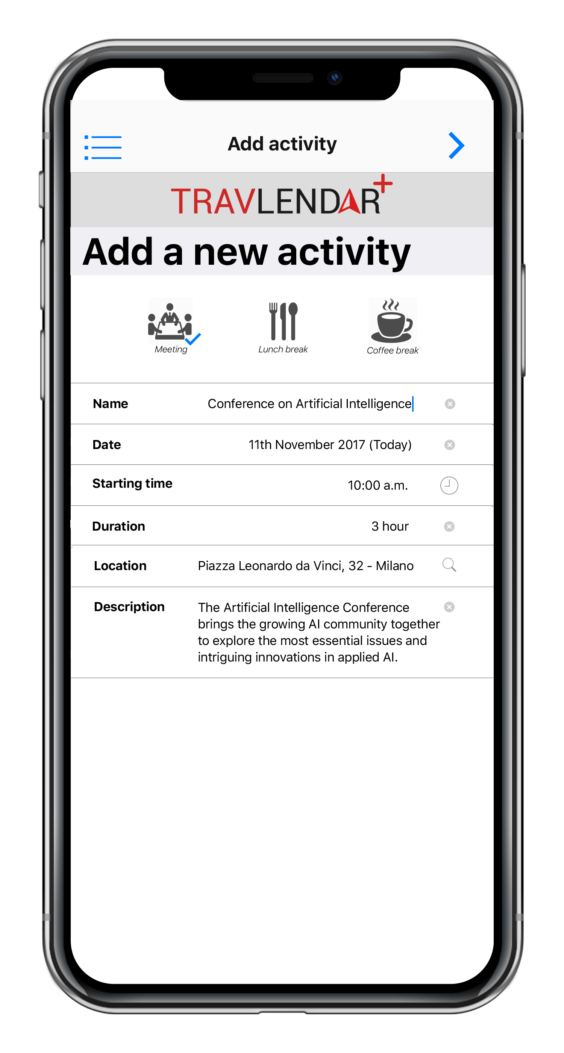
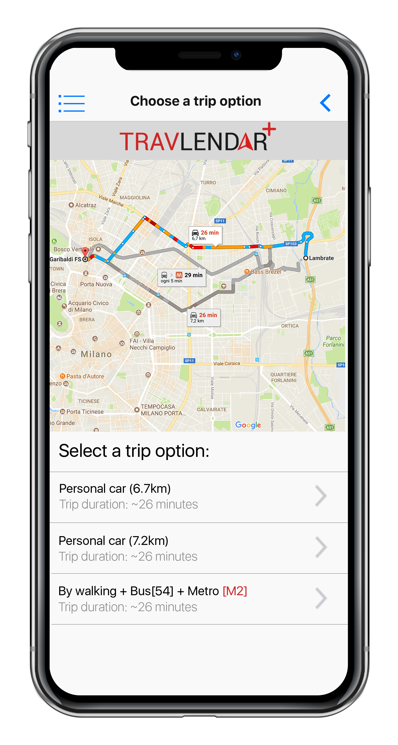
Some Mockups (2)

Slide 22
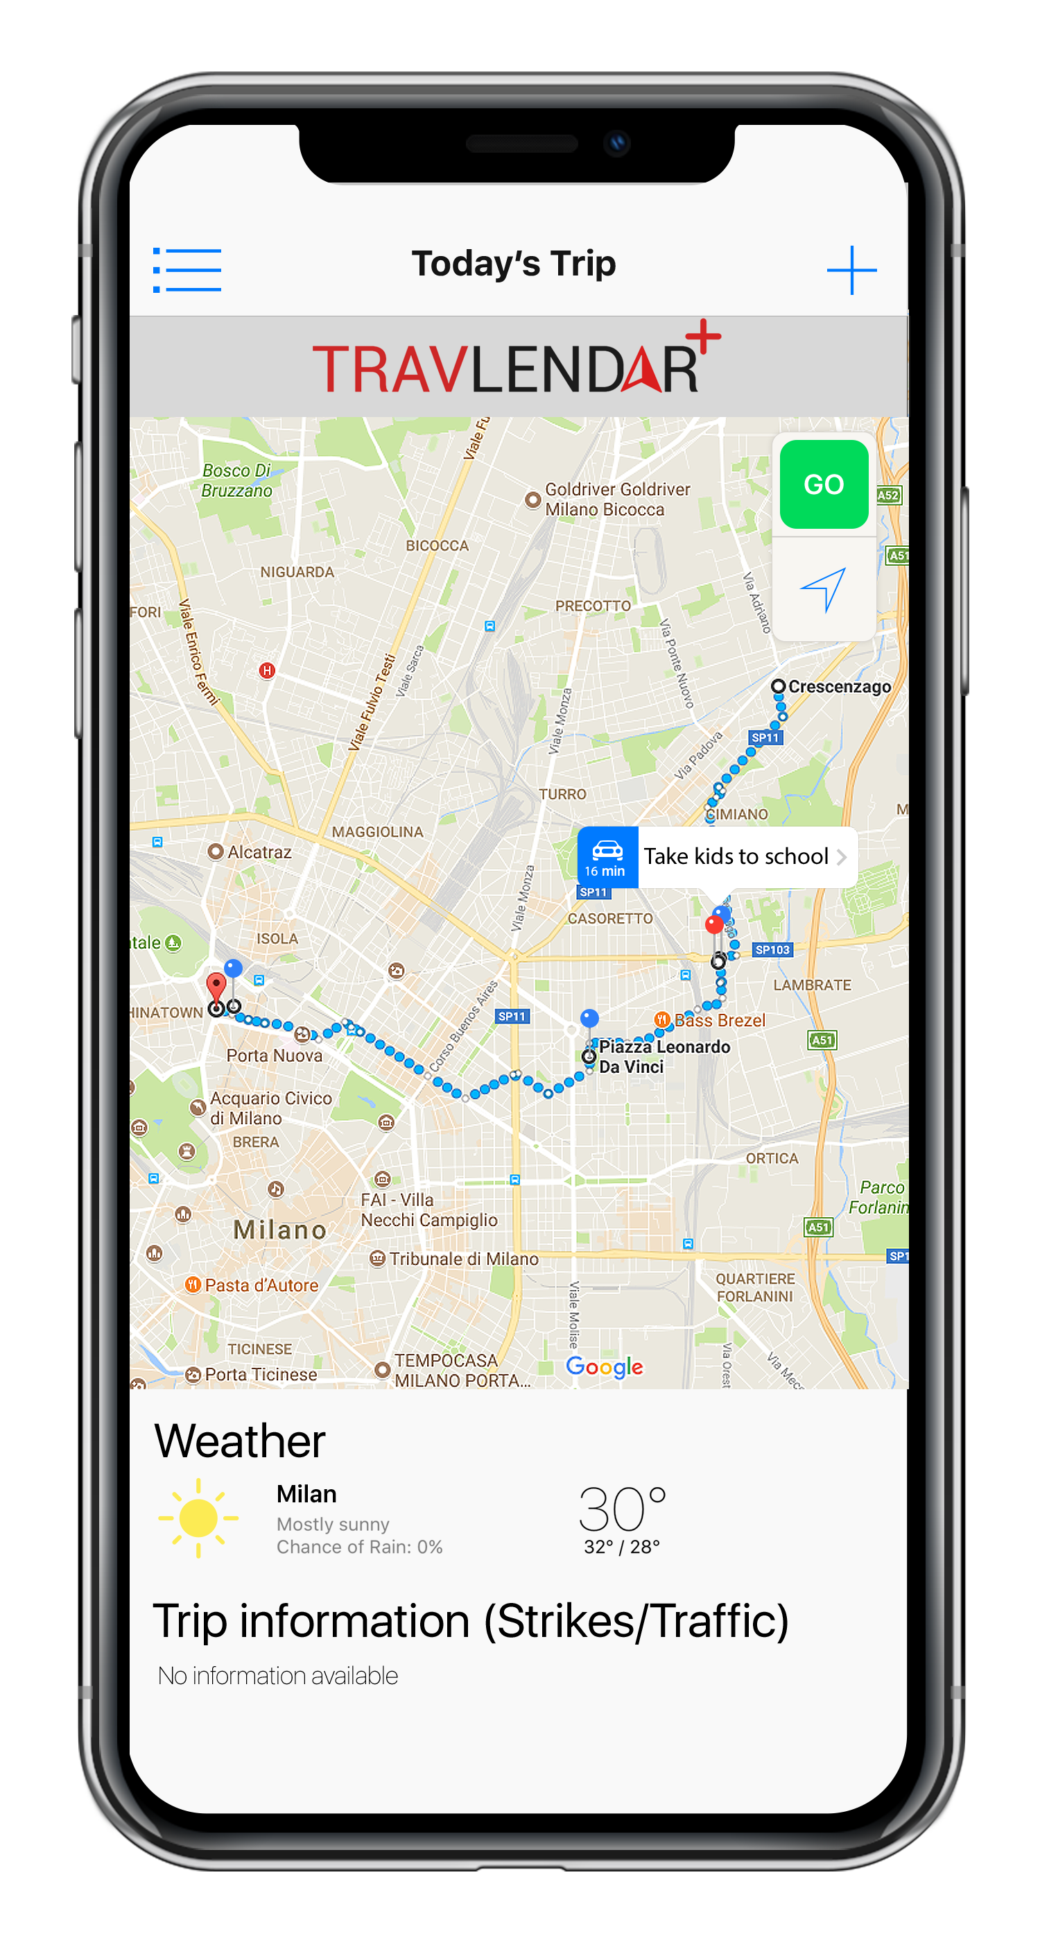
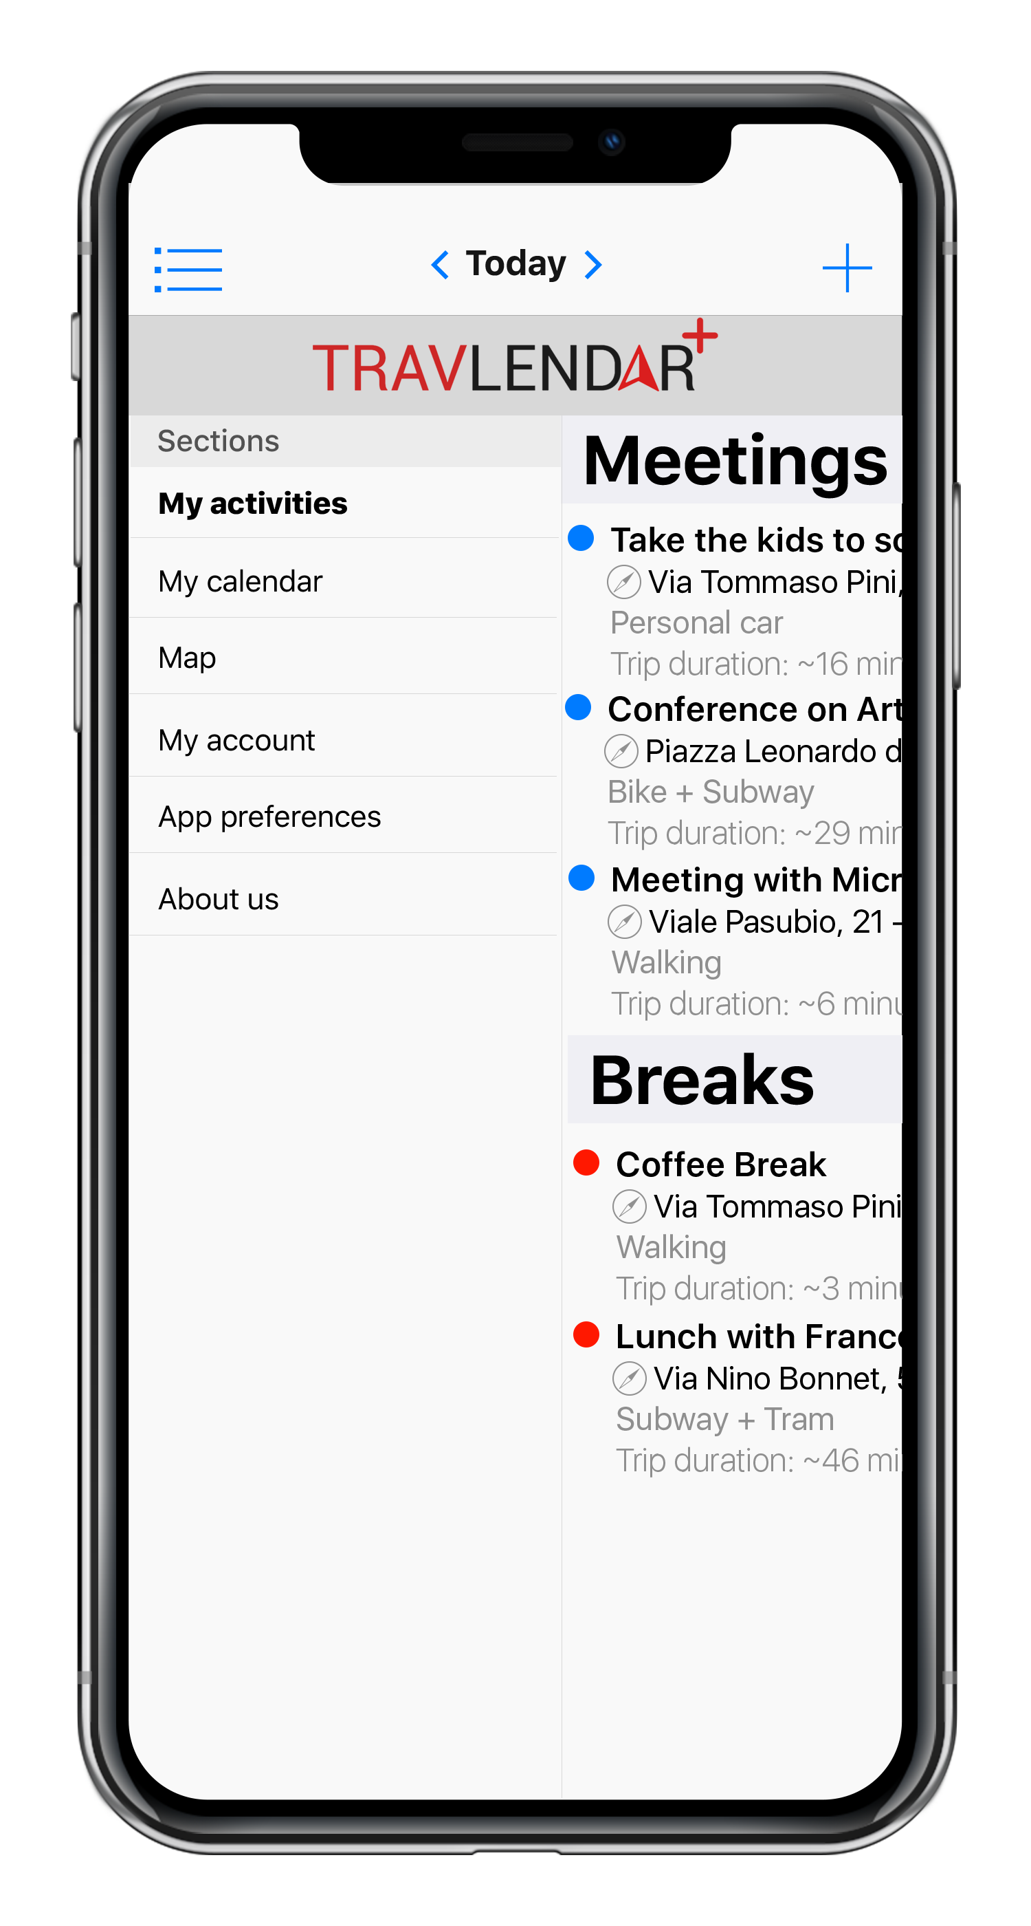
Some Mockups (3)

Slide 23
Test plan
Thread testing
Thread -> A portion of several modules that together provide a user-visible program feature
Threads are integrated and tested incrementally as subsystems and then performed as a whole system
Critical modules integration testing
Prioritize the test of features and functions in software, based on risk of failure and the function of their importance

